Slide 1
The Southern Accent
Katherine Rothbart, Jacob Dyas, Damon Hebb, Ezekiel Craig, and James Shabel

Slide 2
Overview
After seeing the current inventory process first hand, our goal was to create an inexpensive solution to speed up the upload of inventory to a mobile/web-based app that also had the ability to add, edit, or remove items simultaneously with the website.
We have designed a new inventory system that requires minimum physical systems in place, while still maintaining the security and full functionality needed for business operations

Slide 3
Current Problems
Inventory may some times take weeks to get onto website
Process is time consuming and labor intensive
Sometimes inventory doesn’t make it to website at all

Slide 4
Our Solution
Streamline
Streamline inventory process with mobile web based app
Dual Functionality
User will be able to simultaneously upload, edit, or remove inventory from website and application
Remove
Remove tedious and physical process of pulling inventory out, collecting photos, placing inventory back, and uploading pictures and description onto website

Slide 5

Mobile Version

Slide 6
Creating a user profile

Slide 7
Viewing/Searching Inventory

Slide 8
Adding Inventory

Slide 9
Editing Inventory

Slide 10
Add sale

Slide 11
Add sale

Slide 12
Remove Item from Inventory

Slide 13
Desktop Version

Slide 14
Create Personal Profile

Slide 15
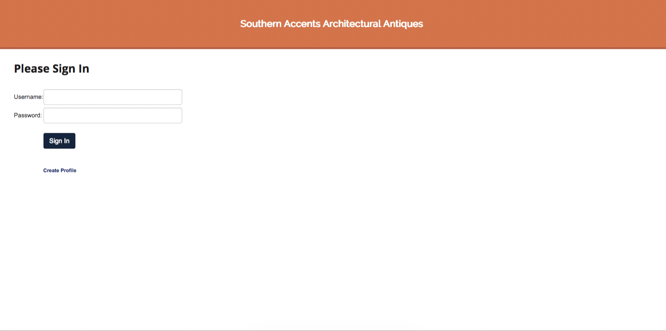
Login Page

Slide 16
Inventory Profile Page

Slide 17
Create Product Profile

Slide 18
Add Sale

Slide 19
View/Search Inventory

Slide 20
Integration with Current System
The initial launch of the new inventory system would be slow and require every item currently in stock to be manually inventoried through the app
After this is accomplished and all the items are in the same database, adding or removing items can be done swiftly through the web/mobile application

Slide 21
Estimated Costs
Apps with these functions can cost around $20,000-$40,000 depending on features/design from an app developing company
Free lance developers usually chare $8,000-$10,000 for similar work
Since our application is used as software as a service there would be an monthly fee of around average of $30

Slide 22
Possible Future Implementations
Add customer portal for purchasing
Potential to implement augmented reality for customers to display items in their home before purchase to reduce returned items

Slide 23
QUESTIONS??

